Slide 1
Deep learning- introduction
Umarani Jayaraman

Slide 2
Outline
What is AI?
Machine Learning vs Deep Learning
Types of learning algorithms
Types of deep learning

Slide 3
What is AI?
AI - Make Computers Think and Behave like Humans

Slide 4
What tasks are easy for a computer?

Slide 5
What tasks are easy for a computer?
AI- Make Computers Think and Behave like Humans
Formal and Mathematical rules - Easy for Computers
Example?

Slide 6
What tasks are easy for a computer?
AI - Make Computers Think and Behave like Humans
Formal and Mathematical rules - Easy for Computers
Example?
Solving mathematical equations, addition, multiplication and similar calculations

Slide 7
What tasks are easy for a Humans?
AI - Make Computers Think and Behave like Humans

Slide 8
What tasks are easy for a Humans?
AI - Make Computers Think and Behave like Humans
Intuitive Problems for Humans
Example?

Slide 9
What tasks are easy for a Humans?
AI - Make Computers Think and Behave like Humans
Intuitive Problems for Humans
Example?
Speech, Text, Visual Recognition, etc.

Slide 10
What tasks are easy for a Humans?
AI - Make Computers Think and Behave like Humans
Intuitive Problems for Humans
Example?
Speech, Text, Visual Recognition, etc.
Easy for Humans but difficult for computers

Slide 11
What tasks are easy for a Humans?
AI - Make Computers Think and Behave like Humans
Intuitive Problems for Humans
Example?
Speech, Text, Visual Recognition, etc.
Easy for Humans but difficult for computers

Slide 12
What tasks are easy for a Humans?
AI - Make Computers Think and Behave like Humans
Intuitive Problems for Humans
Example?
Speech, Text, Visual Recognition, etc.
Easy for Humans but difficult for computers
Intuitive Problems - Complex concepts can be broken to simple concepts.

Slide 13
What tasks are easy for a Humans?
Intuitive Problems - Complex concepts can be broken to simple concepts.
Example: An Image(Complex for computers) can be broken into edges, intensity values, objects (like face, nose, eyes), contours, and corners.

Slide 14
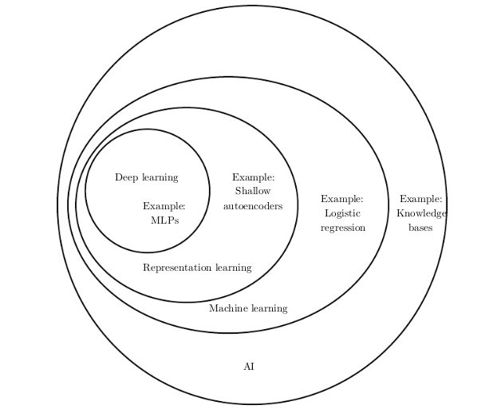
Relation between AI and other types of learning

Slide 15
What is AI, ML and deep learning?
Artificial Intelligence- Any technique that enables computer to mimic human behavior
Machine Learning
Hand crafted features
Ability to learn without explicitly being programmed
Deep Learning
Features extraction is built in it
Extract patterns from data using neural networks

Slide 16
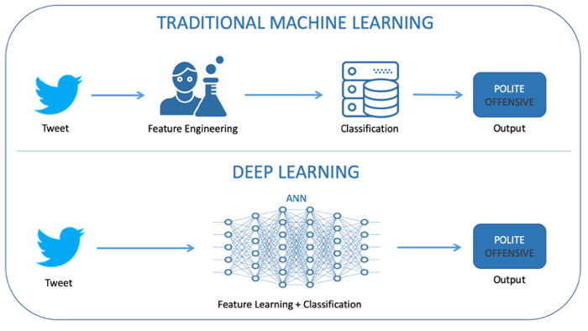
Machine learning vs deep learning

Slide 17
What is deep learning
Deep Learning definition => Subjective

Slide 18
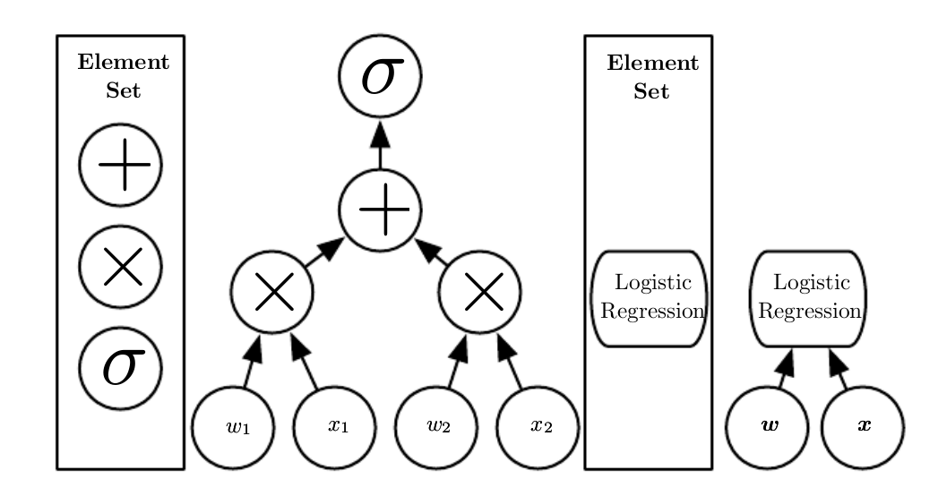
Deep Learning Definition: Computational Graph (Step)

Slide 19
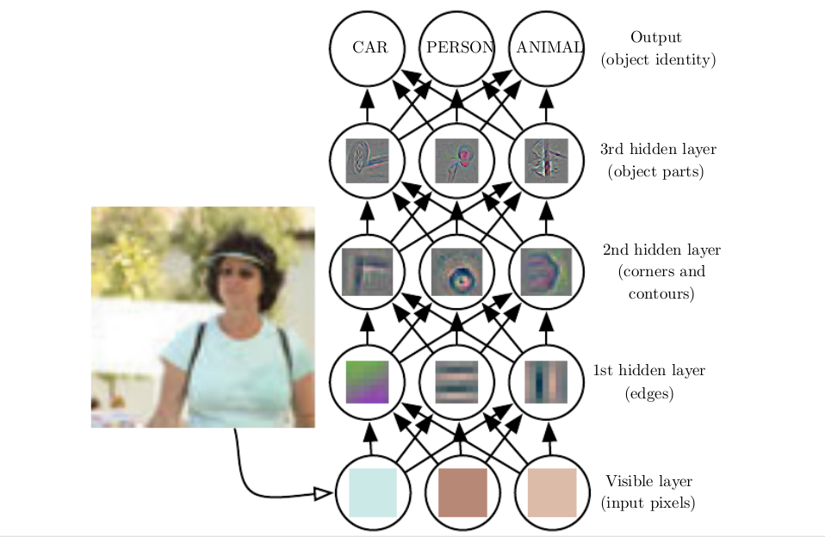
Deep Learning Definition: Hierarchical Relation

Slide 20
What is the goal of deep learning
Deep Learning definition => Subjective.
Learn: Gather knowledge from past Experience or data.
Deep Learning: Gather knowledge using simple hierarchical layer representation of a complex concept from past Experiences.
Goal: Solve intuitive problems and reduce, or remove human intervention/expertise.

Slide 21
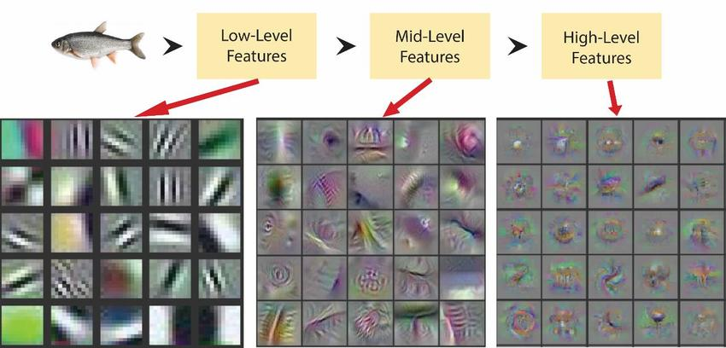
Why deep learning?
Hand crafted (or) engineering features are time consuming, hard and not scalable in practice
Is it possible to learn the underlying features directly from data?

Slide 22
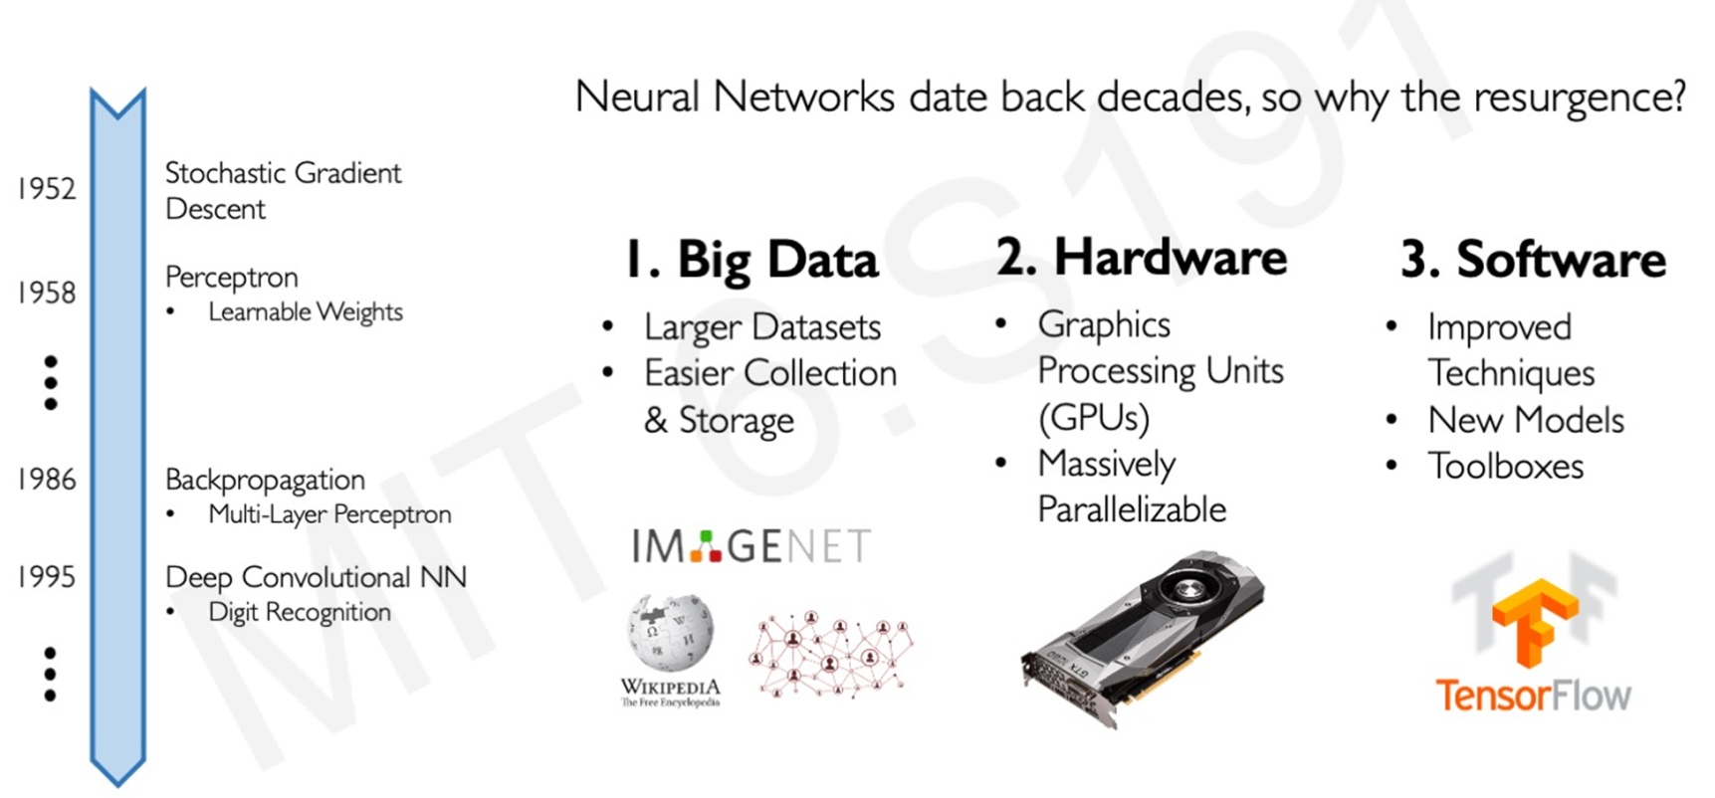
Why now deep learning trending?
Neural networks evolved in the year 1952

Slide 23
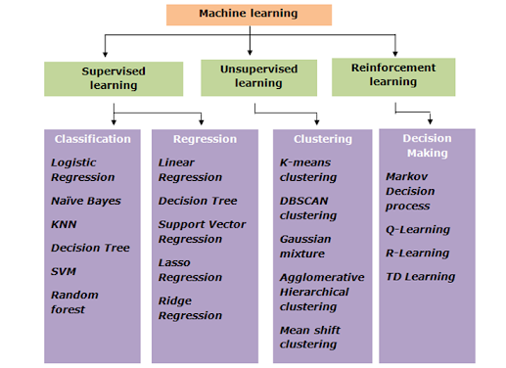
Learning algorithm in machine learning

Slide 24
Learning algorithm in deep learning
Supervised learning
Unsupervised learning
Reinforcement learning

Slide 25
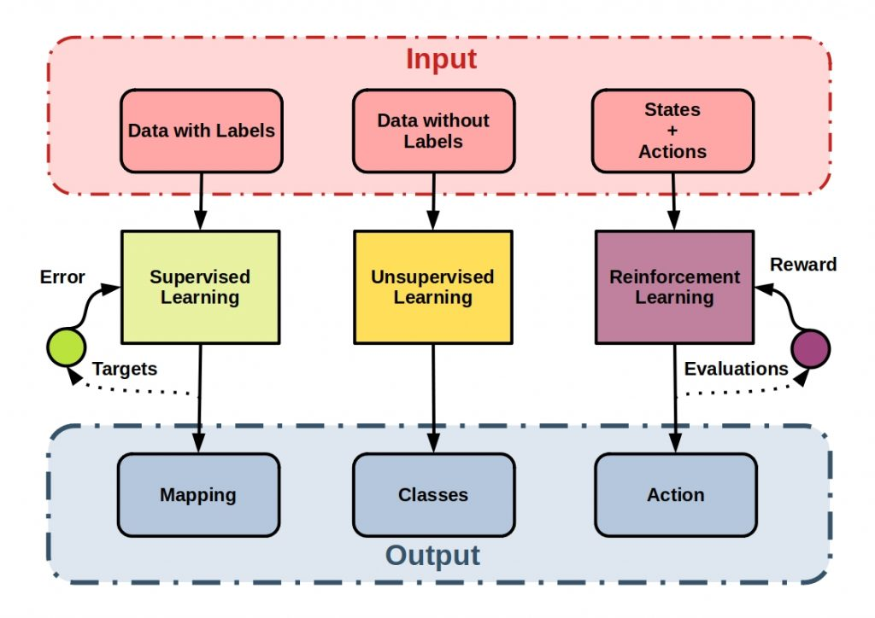
Types of deep learning

Slide 26
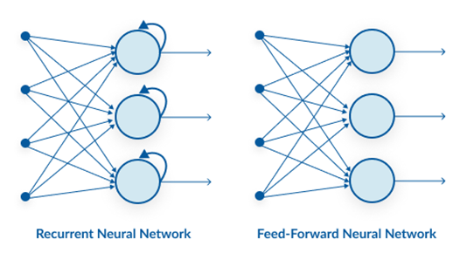
Types of deep learning based on direction of data flow
Feed forward neural network
Recurrent neural network

Slide 27
Feed Forward Neural Networks - Example Networks
Feed Forward Neural Network
Perceptron and Multi-Layer Perceptron(MLP), Fully connected Neural Network or Artificial Neural Network (ANN)
Convolutional Neural Network
AlexNet
VGG16 and VGG19
ResNet and DenseNet
InceptionNet and GoogleNet
Squeeze & ExcitationNet (SENet)
MobileNet, EfficientNet and Normalizer Free Network (NF Nets)
Generative Adversarial Network (GANs)
Transformers
Bidirectional Encoder Representations from Transformers (BERT)
Generative Pretrained Transformers (GPT - 1, 2, 3, ..)
Vision Transformers
Capsule Network

Slide 28
Recurrent Neural Networks - Example Networks
Recurrent Neural Networks (RNN)
Long Short-Term Memory (LSTM)
Gated Recurrent Unit (GRU)
Fully Recurrent Networks
Hopfield RNN
Neural Turing Machines
Differentiable Neural Computers
Bidirectional RNN
Echo State RNN
Continuous Time RNN
Recursive RNN
Neural History Compressor
Neural Network Pushdown Automata
Memristive Networks

Slide 29
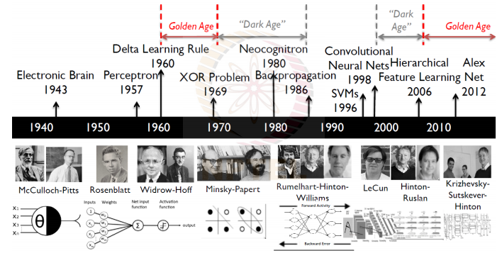
History of deep learning
Source: https://drive.google.com/file/d/1K9XXCJGH_IXLCJ3LgYgsrP4614q2Kxbx/view?usp=sharing

Slide 30
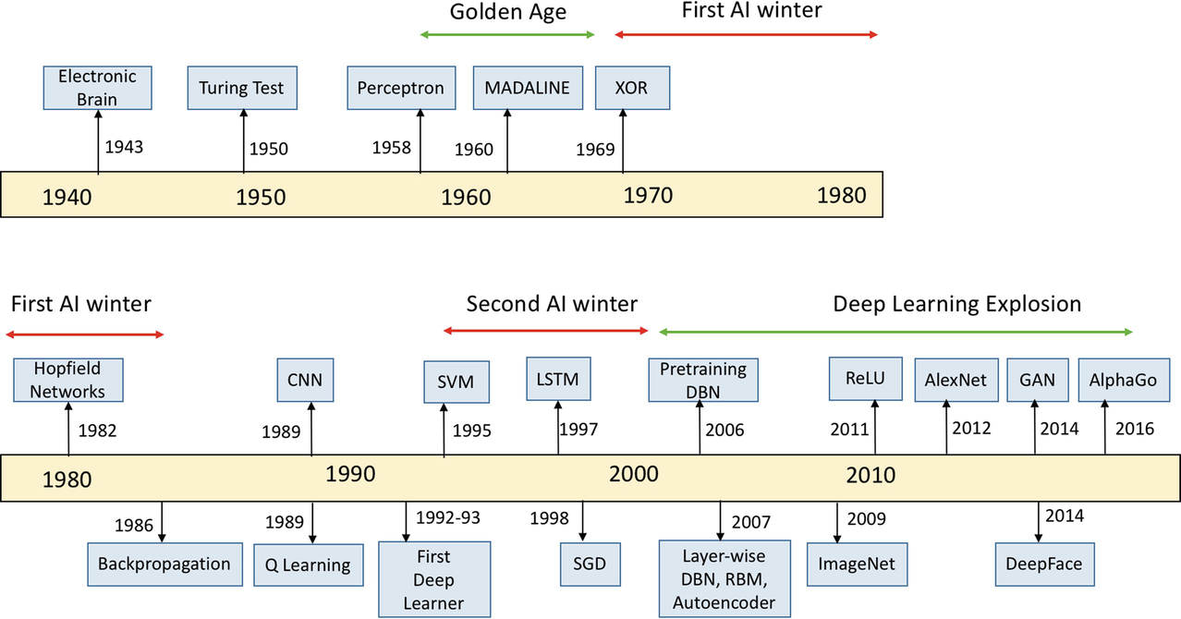
History of deep learning
Source: https://bit.ly/35xXLwu
Chapter1- Deep Learning by Ian Goodfellow

Slide 31
Top researchers in deep learning
Yoshua Bengio, professor, Université de Montreal, Quebec, Canada.
Turing Award
Bengio received the 2018 ACM A.M. Turing Award (often referred to as the "Nobel Prize of Computing"), together with Geoffrey Hinton and Yann LeCun, for their work on deep learning. Bengio, Hinton, and LeCun are sometimes referred to as the "Godfathers of AI" and "Godfathers of Deep Learning".
https://yoshuabengio.org/profile/#:~:text=He%20is%20Co%2DDirector%20of,world%20(h%2Dindex).

Slide 32
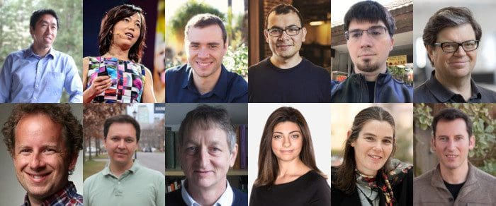
https://analyticsindiamag.com/top-10-deep-learning-researchers-who-are-re-defining-its-application-areas/

Slide 33
Thank you

